Slide 1

Drugs Consumption Prediction

Slide 2
About me:
Vurukonda Shiva Sai Chakradhar
BCA
Why you want to learn Data Science
I want to learn Data Science because am curious about how we can use information to solve problems and make things better. I believe data science gives use the tools to do that by analysing data and finding patterns that can lead to smarter decisions and innovations.
Linkedin link: https://www.linkedin.com/in/shivasaichakradhar

Slide 3
Business problem : Drug usage classification involves predicting the frequency of drug consumption among individuals based on their demographic, socio-economic, and psychological characteristics. The target variable ranges from 'never used' (CL0) to 'used in the last day' (CL6). Each category represents different levels of recent drug consumption, providing valuable insights into patterns of substance use over time
Objectives:
Predictive Modeling: Develop machine learning models to accurately classify individuals into different drug usage categories (CL0 to CL6) based on available data.
Feature Analysis: Identify and analyze demographic, socio-economic, and psychological features that significantly impact drug usage patterns. This includes exploring correlations between variables and understanding their predictive power.
Insights for Intervention: Provide actionable insights for healthcare providers and policymakers to design targeted interventions. These insights could include identifying high-risk groups, understanding regional variations in drug usage, and evaluating the effectiveness of current prevention strategies.

Slide 4

Tools used

Slide 5
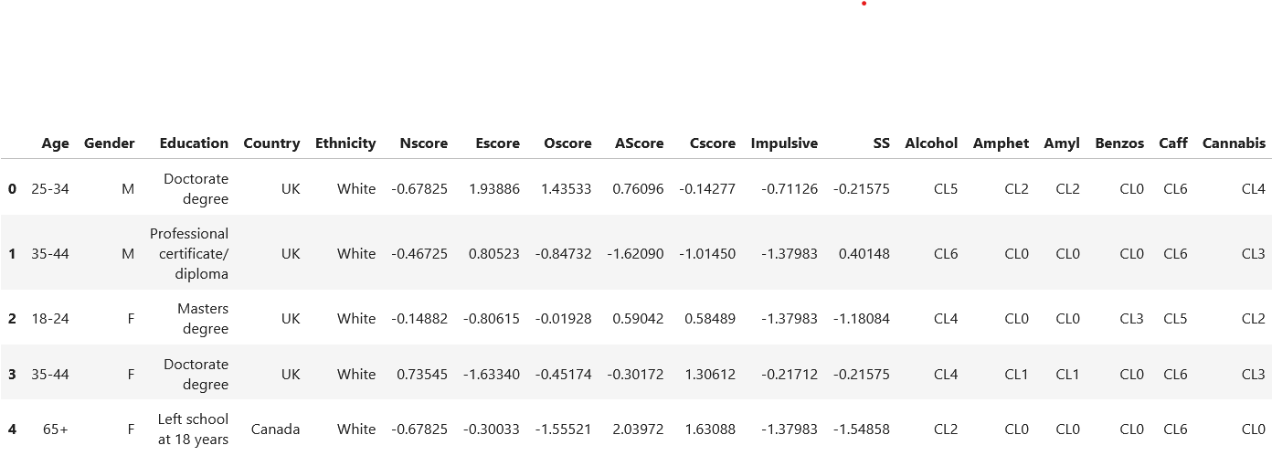
Data cleaning
As there are no null values and duplicates in the data there is no need of cleaning the data
there are 1884 rows and 31 columns

Slide 6
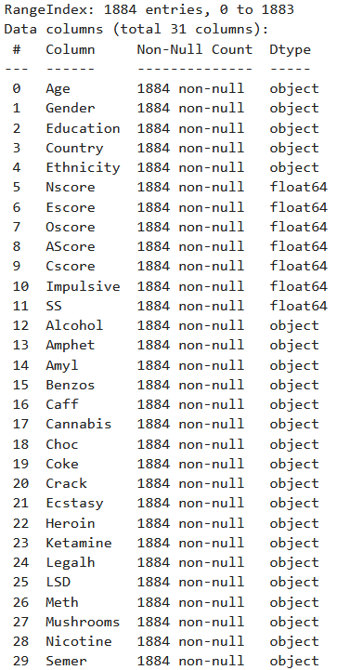
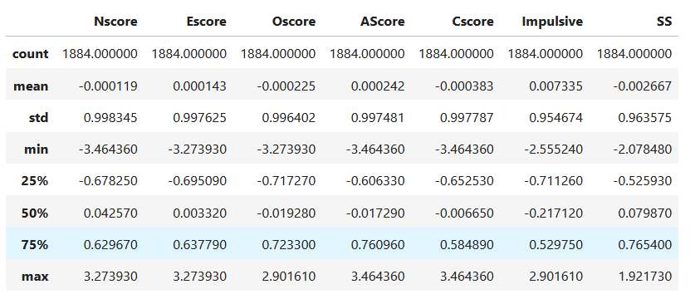
Data information
The image given in the left side has the information of the total data set
Shows that there are no null values ,and columns are in 24 Object ,7 Float
The image given above are the only numerical description of the Data
Shows mean, standarded, count,min,max ,75% ,50% ,25% of columns

Slide 7
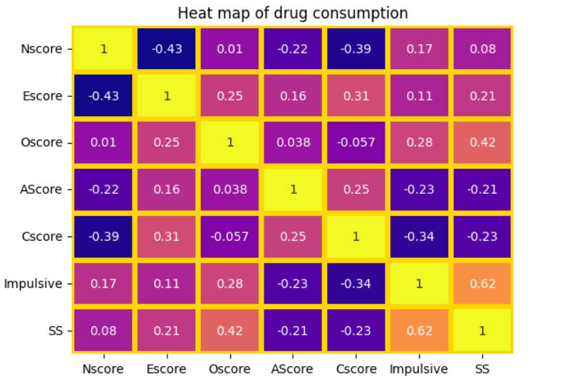
Data visulaiztion
According to correlation in the heatmap impulse vs ss has the the highest correlation
Where as negative correlation in escore vs nscore

Slide 8
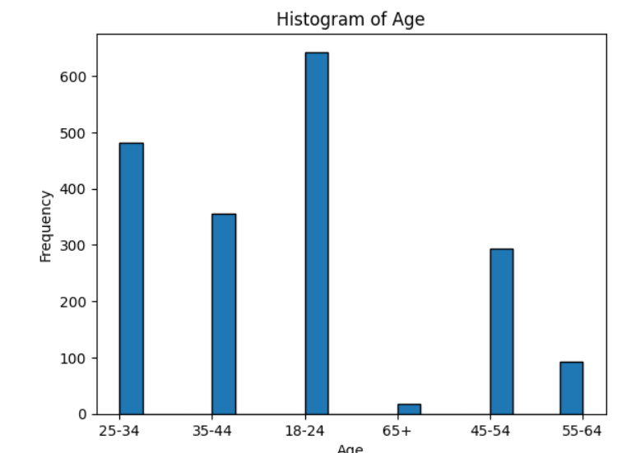
Histogram plot
The '25-34' age group has the highest frequency, indicating a larger count of individuals in this category.
There is a noticeable decrease in frequency for age groups '65+’ and '55-64', showing fewer individuals in these ranges.
This histogram displays a skewed distribution towards younger ages, with '35-44' and '45-55' also having substantial counts.

Slide 9
Data preprocessing
Imputed the interqurtiles to the data which will handle the outliers
After imputing found null values dropped them there fore the no of rows decreased to 1803
After this stored input columns in the x and Target column in the y
Applied Label encoding on all the catogerical data columns they are totally 24 catogerical columns converted to numerical using label encoding

Slide 10
Feature Selection
Done future selection and got the which features are important
The total no of important features are 15 columns
the feature selction has taken all columns which score is above 0.03
Stored all the features columns in the x variable

Slide 11
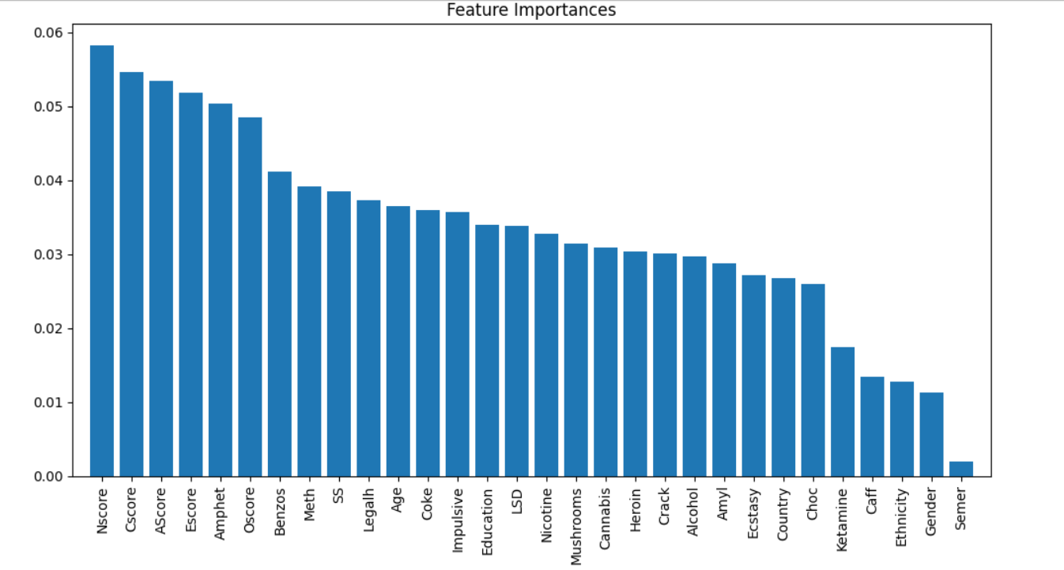
Feature importance diagram

Slide 12
Model Building :
The model building was build using Pipeline we had done 7 different algorithms
Logistic Regression
Decision Tree
K_NN
Naïve Baye’s
Gradient Descent
Random Forest
Support Vector Machine
Logistic Regression
Decision Tree
K_NN
Naïve Baye’s
Gradient Descent
Random Forest
Support Vector Machine

Slide 13
Hyper parameter tuning
The hyper parameter tuning was done on algorithms like
Logistic Regression,Decision Tree,K_NN,Naïve Baye’s,Gradient Descent,Random Forest,Support Vector Machine.
Hyperparameter tuning done using grid search cv and random search cv
Included the evalution score like Accuracy,Precision,F1Score,recall

Slide 14
GridSearchCV RandomSearchCV
S no | Algorithm Name | Metric_Score
1 | Logistic Regression | Accuracy: 0.783Precision: 0.695Recall: 0.783F1-score: 0.705
2 | Decision Tree | Accuracy: 0.787Precision: 0.620Recall: 0.787F1-score: 0.693
3 | K_NN | Accuracy: 0.752Precision: 0.659Recall: 0.752F1-score: 0.697
4 | Naïve Baye’s | Accuracy: 0.663Precision: 0.720Recall: 0.663F1-score: 0.686
5 | Gradient Descent | Accuracy: 0.785Precision: 0.619Recall: 0.785F1-score: 0.692
6 | Random Forest | Accuracy: 0.787Precision: 0.620Recall: 0.787F1-score: 0.693
7 | Support Vector Machine | Accuracy: 0.787Precision: 0.620Recall: 0.787F1-score: 0.693
S No | Algorithm Name | Metric Score
1 | Logistic Regression | Accuracy: 0.758Precision: 0.649Recall: 0.758F1-score: 0.685
2 | Decision Tree | Accuracy: 0.774Precision: 0.599Recall: 0.774F1-score: 0.675
3 | K_NN | Accuracy: 0.756Precision: 0.661Recall: 0.756F1-score: 0.690
4 | Naïve Baye’s | Accuracy: 0.676Precision: 0.709Recall: 0.676F1-score: 0.686
5 | Gradient Descent | Accuracy: 0.774Precision: 0.599Recall: 0.774F1-score: 0.675
6 | Random Forest | Accuracy: 0.763Precision: 0.625Recall: 0.763F1-score: 0.678
7 | Support Vector Machine | Accuracy: 0.774Precision: 0.599Recall: 0.774F1-score: 0.675

Slide 15
Summary of The Data
There data set contains 24 categorical columns which 18 of them which are about drugs last categorical column is VSA (drugs consumption when) which is also target column has categories of (CL0 to CL6)never used the drug ,used it over a decade ago, used in the last decade, used in the last year, used in the last month, used in the last week, used in the last day .
remaining categorical columns are Age ,Gender ,Education , Country, Ethicity
8 numerical columns Nscore, Oscore , Ascore ,Escore , Cscore , Impulsive , SS(Sensation Seeking)

Slide 16
Numerical data in detail
Nscore | Quantified NEO Five-Factor Inventory Neuroticism score
Escore | Quantified NEO Five-Factor Inventory Extraversion score
Oscore | Quantified NEO Five-Factor Inventory Openness to experience score
Ascore | Quantified NEO Five-Factor Inventory Agreeableness score
Cscore | Quantified NEO Five-Factor Inventory Conscientiousness score
Impulsive | Quantified BIS-11 impulsiveness score
SS | Quantified Impulsive Sensation Seeking score

Slide 17
Based on the project evaluation, Naive Bayes exhibited the shortest training time at 0.01 seconds, with Decision Tree showing the fastest prediction time at 0.004 seconds. Conversely, Support Vector Machine (SVM) required the longest training time at 1.43 seconds, while K-Nearest Neighbors (KNN) had the highest prediction time at 0.095 seconds. The Random Forest classifier emerged as the best-performing model with a best score of 0.783. It demonstrated robust performance across various evaluation metrics, particularly in terms of accuracy and recall, making it suitable for the classification task at hand. Both Random Search CV and Gradient Search CV confirmed its superiority among the evaluated models.
Challenges Faced
The main challenge was the data understanding where there were 24 object columns and 7 float data type coloumns when creating the pipeline I was stuck which parameters should be used in the each algorithm by the help of Toward Data Science website I learned from there and kept the parameters
Conclusion

Slide 19


